Slide 1
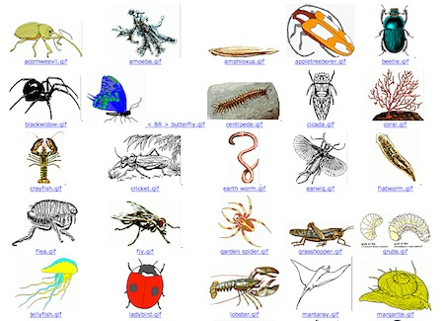

Slide 2
Types of Skeletal Systems
uca.edu/steminstitute/files/2011/07/TheMuscularSystem.pptx
Changes in movement occur because muscles pull against a support structure, called the skeletal system
-Zoologists recognize three types:
-Hydrostatic skeletons
-Exoskeletons
-Endoskeletons

Slide 3
Hydrostatic Skeletons
uca.edu/steminstitute/files/2011/07/TheMuscularSystem.pptx
Are found primarily in soft-bodied invertebrates, both terrestrial and aquatic
Locomotion in earthworms
-Involves a fluid-filled central cavity and surrounding circular & longitudinal muscles
-A wave of circular followed by longitudinal muscle contractions move fluid down body
-Produces forward movement

Slide 4
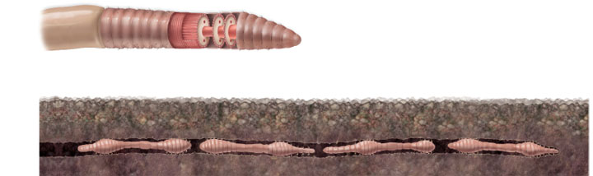
uca.edu/steminstitute/files/2011/07/TheMuscularSystem.pptx
Hydrostatic Skeletons
Copyright © The McGraw-Hill Companies, Inc. Permission required for reproduction or display.
Longitudinal muscles
Anterior
Longitudinal muscles
contract, and segments
catch up
Circular muscles
Longitudinal muscles contracted
Circular muscles
contracted
Circular muscles
contract, and anterior
end moves forward
Circular muscles
contract, and anterior
end moves forward

Slide 5
Hydrostatic Skeletons
uca.edu/steminstitute/files/2011/07/TheMuscularSystem.pptx
Locomotion in aquatic invertebrates
-Occurs by fluid ejections or jetting
-Jellyfish produce regular pulsations in bell
-Squeezing some of water contained beneath it
-Squids fill mantle cavity with sea water
-Muscular contractions expel water forcefully through the siphon, and the animal shoots backward

Slide 6
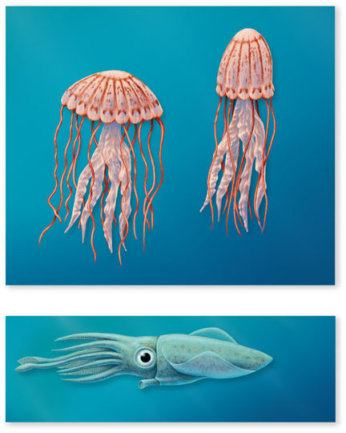
Copyright © The McGraw-Hill Companies, Inc. Permission required for reproduction or display.
uca.edu/steminstitute/files/2011/07/TheMuscularSystem.pptx
Jellyfish
propelled
upward
Bell
Contractile fibers
Bell
pulsates
Water
expelled
from bell
Water
enters
bell
a.
Squid
propelled
backward
Water expelled
from siphon
b.

Slide 7
Exoskeletons
uca.edu/steminstitute/files/2011/07/TheMuscularSystem.pptx
The exoskeleton surrounds the body as a rigid hard case
-Composed of chitin in arthropods
An exoskeleton provides protection for internal organs and a site for muscle attachment
-However, it must be periodically shed, in order for the animal to grow
-It also limits body size

Slide 8
Endoskeletons
uca.edu/steminstitute/files/2011/07/TheMuscularSystem.pptx
Endoskeletons are rigid internal skeletons that form the body’s framework and offer surfaces for muscle attachment
-Echinoderms have calcite skeletons, that are made of calcium carbonate
-Bone, on the other hand, is made of calcium phosphate

Slide 9
Locomotion in Water
novellaqalive.mheducation.com/sites/dl/free/9834092339/415942/chapt47_lecture.ppt
Water’s buoyancy reduces effect of gravity
Some marine invertebrates move about using hydraulic propulsion
All aquatic invertebrates swim
-Swimming involves using the body or its appendages to push against the water
-An eel uses its whole body
-A trout uses only its posterior half

Slide 10
Locomotion on Land
novellaqalive.mheducation.com/sites/dl/free/9834092339/415942/chapt47_lecture.ppt
Terrestrial locomotion deals mainly with gravity
Mollusks glide along a path of mucus
Vertebrates and arthropods have a raised body, and move forward by pushing against the ground with jointed appendages – legs
-Vertebrates are tetrapods; all arthropods have at least six limbs
-Having extra legs increases stability, but reduces the maximum speed

Slide 11
Locomotion on Land
novellaqalive.mheducation.com/sites/dl/free/9834092339/415942/chapt47_lecture.ppt
The basic walking pattern of quadrupeds generates a diagonal pattern of foot falls
-Left hind leg, right foreleg, right hind leg, left foreleg
-Allows running by a series of leaps
Some vertebrates are also effective leapers
-Kangaroos, rabbits and frogs have powerful leg muscles

Slide 12
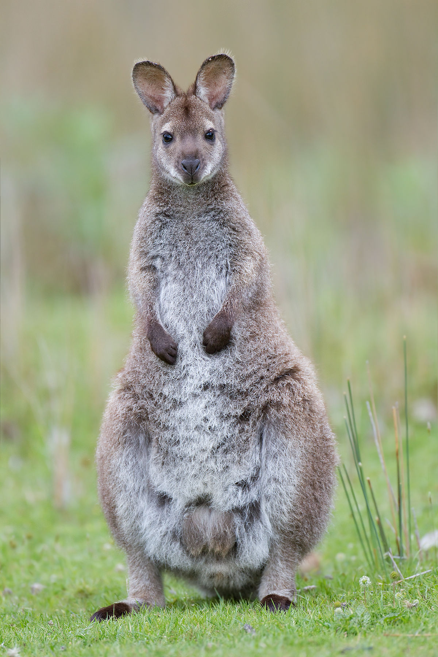
Red-necked wallaby

Slide 13
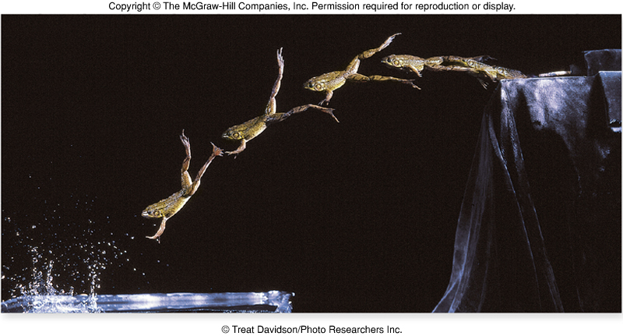
Locomotion on Land
novellaqalive.mheducation.com/sites/dl/free/9834092339/415942/chapt47_lecture.ppt

Slide 14
Locomotion in Air
novellaqalive.mheducation.com/sites/dl/free/9834092339/415942/chapt47_lecture.ppt
Flight has evolved among animals four times
-Insects, pterosaurs (extinct flying reptiles), birds, and bats
-Propulsion is achieved by pushing down against the air with wings
In birds and most insects, wing raising and lowering is achieved by alternate contraction of extensor muscles (elevators) and flexor muscles (depressors)

Slide 15
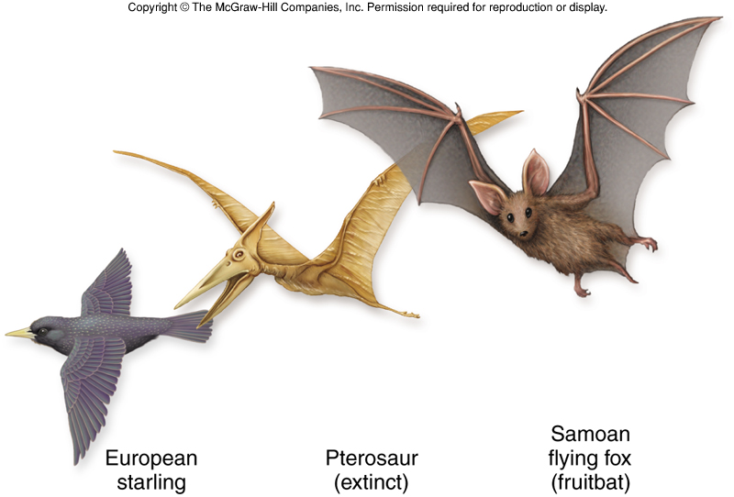
novellaqalive.mheducation.com/sites/dl/free/9834092339/415942/chapt47_lecture.ppt
Locomotion in Air
These different vertebrates all have lightened bones and forelimbs transformed into wings

Slide 16
ASYNCHRONOUS MUSCLE
Asynchronous muscle, the basalar flight muscle of the beetle Cotinus mutabilis
Synchronous wing muscles from the locust, Schistocerca americana.
Because of delayed stretch activation and shortening deactivation, a tetanically stimulated beetle muscle can do work when subjected to repetitive lengthening and shortening. The synchronous locust muscle, subjected to similar stimulation and length change, absorbs rather than produces work.
ROBERT K. JOSEPHSON, JEAN G. MALAMUD AND DARRELL R. STOKES
The Journal of Experimental Biology 203, 2713–2722 (2000)

Slide 17
Approximately three-quarters of the known insect species have asynchronous flight muscles (Dudley, 1991).
Asynchronous muscles are high-frequency muscles. The wing-stroke frequency during flight of insects using asynchronous muscle ranges from approximately 20 Hz in large belostomatid bugs (Barber and Pringle, 1966) to 500–1000 Hz in small midges (Sotavalta, 1947, 1953).
But high-frequency muscles need not be asynchronous. Among high-frequency, synchronous muscles are the shaker muscle of the rattlesnake rattle (up to 90 Hz; Schaeffer et al., 1996; Rome and Lindstedt, 1998), the toadfish soundproducing muscle (over 200 Hz; Fine, 1978; Fine and Mosca, 1989; Rome et al., 1996), the muscles used in stridulation by the katydid Neoconocephalus robustus (200 Hz; Josephson and Halverson, 1971) and the tymbal muscle used in sound production by the cicada Okanagana vanduzeei (550 Hz; Josephson and Young, 1985).
In synchronous muscles, the myofibrils are enveloped by a layer of sarcoplasmic reticulum; in asynchronous muscles, the sarcoplasmic reticulum is sparse and scattered. Muscle activation in both synchronous and asynchronous muscle results from the release of Ca2+ from the sarcoplasmic reticulum in response to fiber depolarization; relaxation follows re-uptake of the released Ca2+ by the sarcoplasmic reticulum. High-frequency operation requires brief contractions. The short twitch duration in synchronous muscle is achieved in part by hypertrophy of the sarcoplasmic reticulum and by a reduction in the diameter of the contractile myofibrils (Josephson and Young, 1987).
Think mitochondria within the fibers. Energy demand.

Slide 18
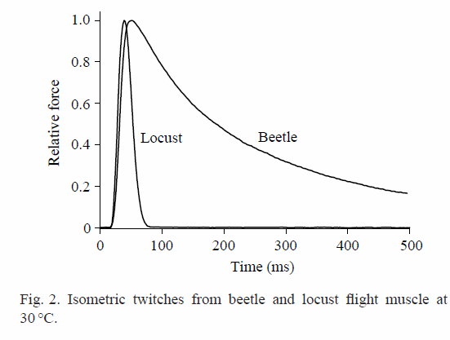

Slide 19
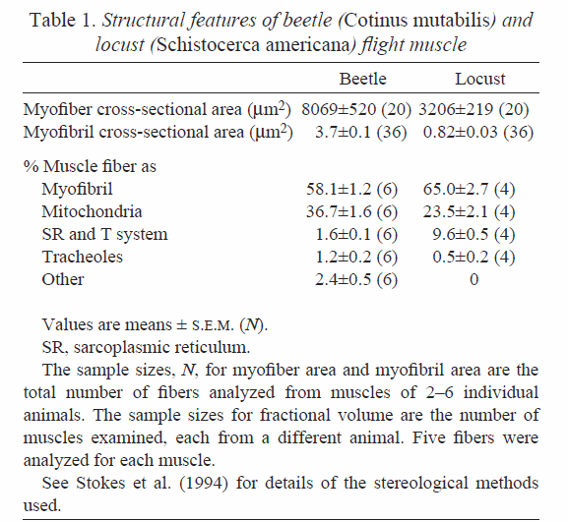

Slide 20
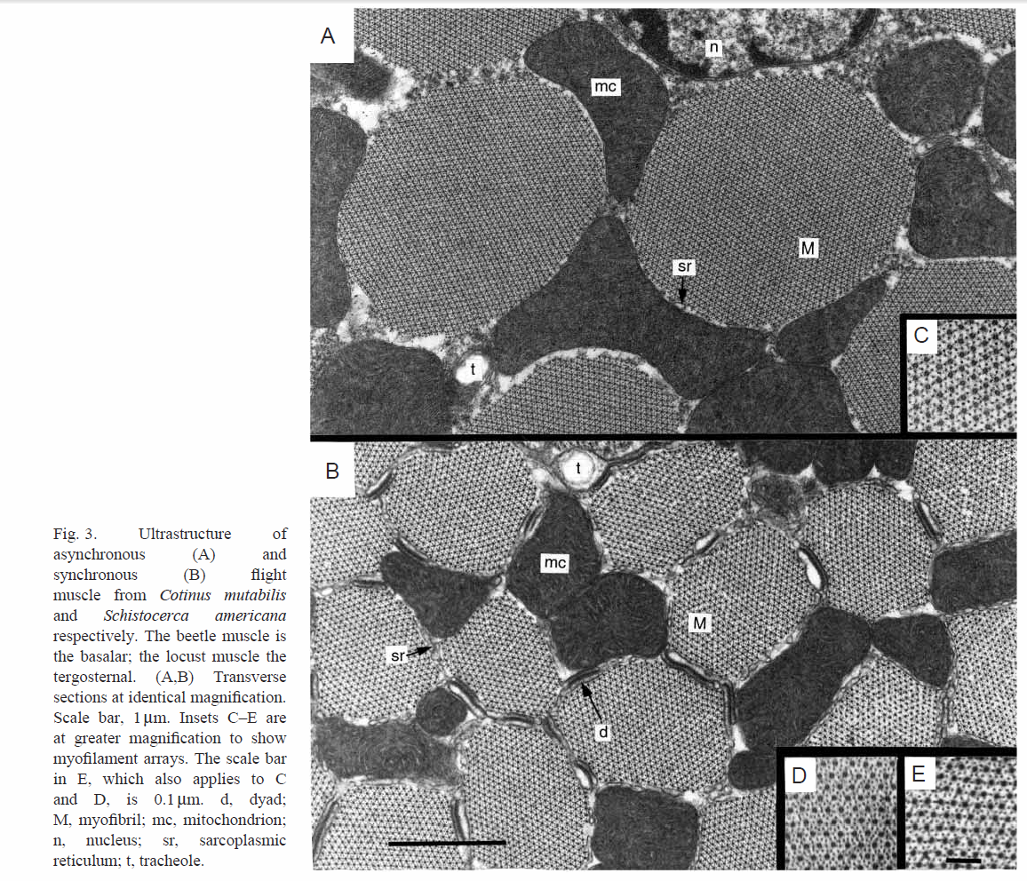

Slide 21
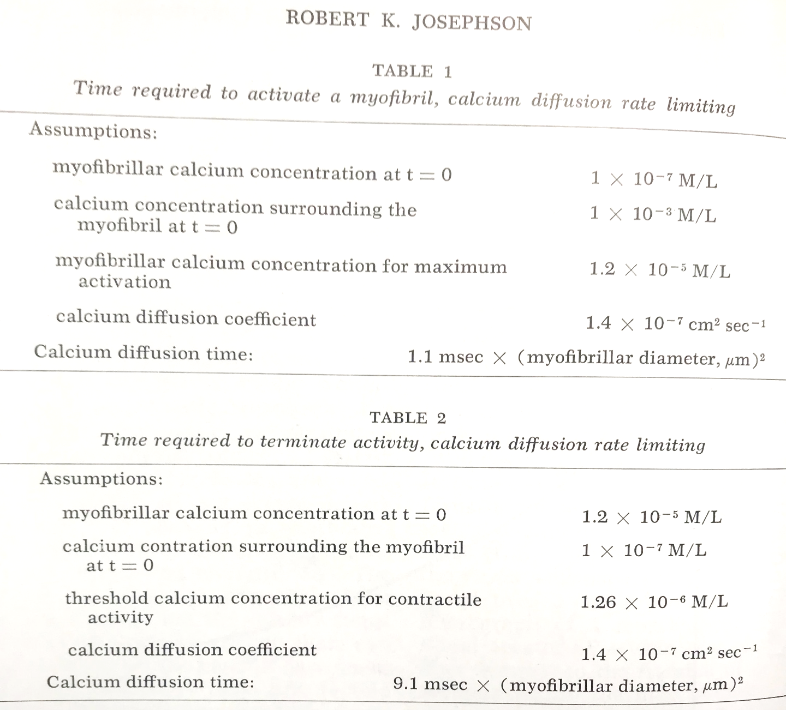

Slide 22
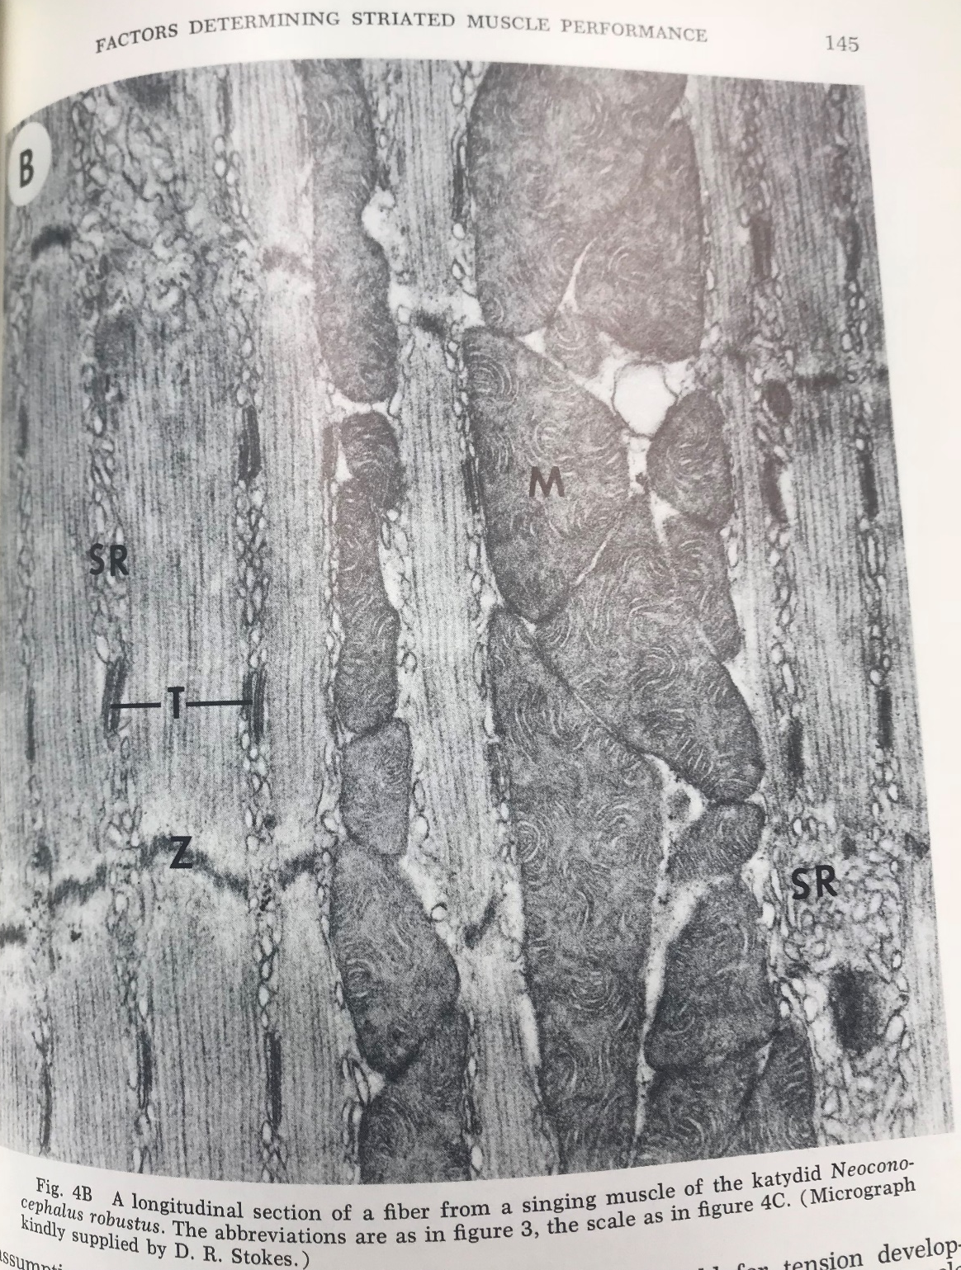

Slide 23
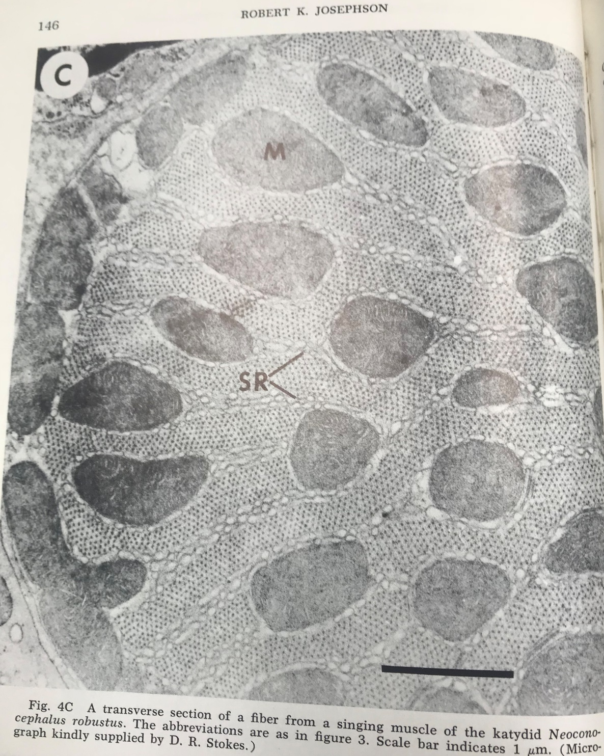

Slide 24
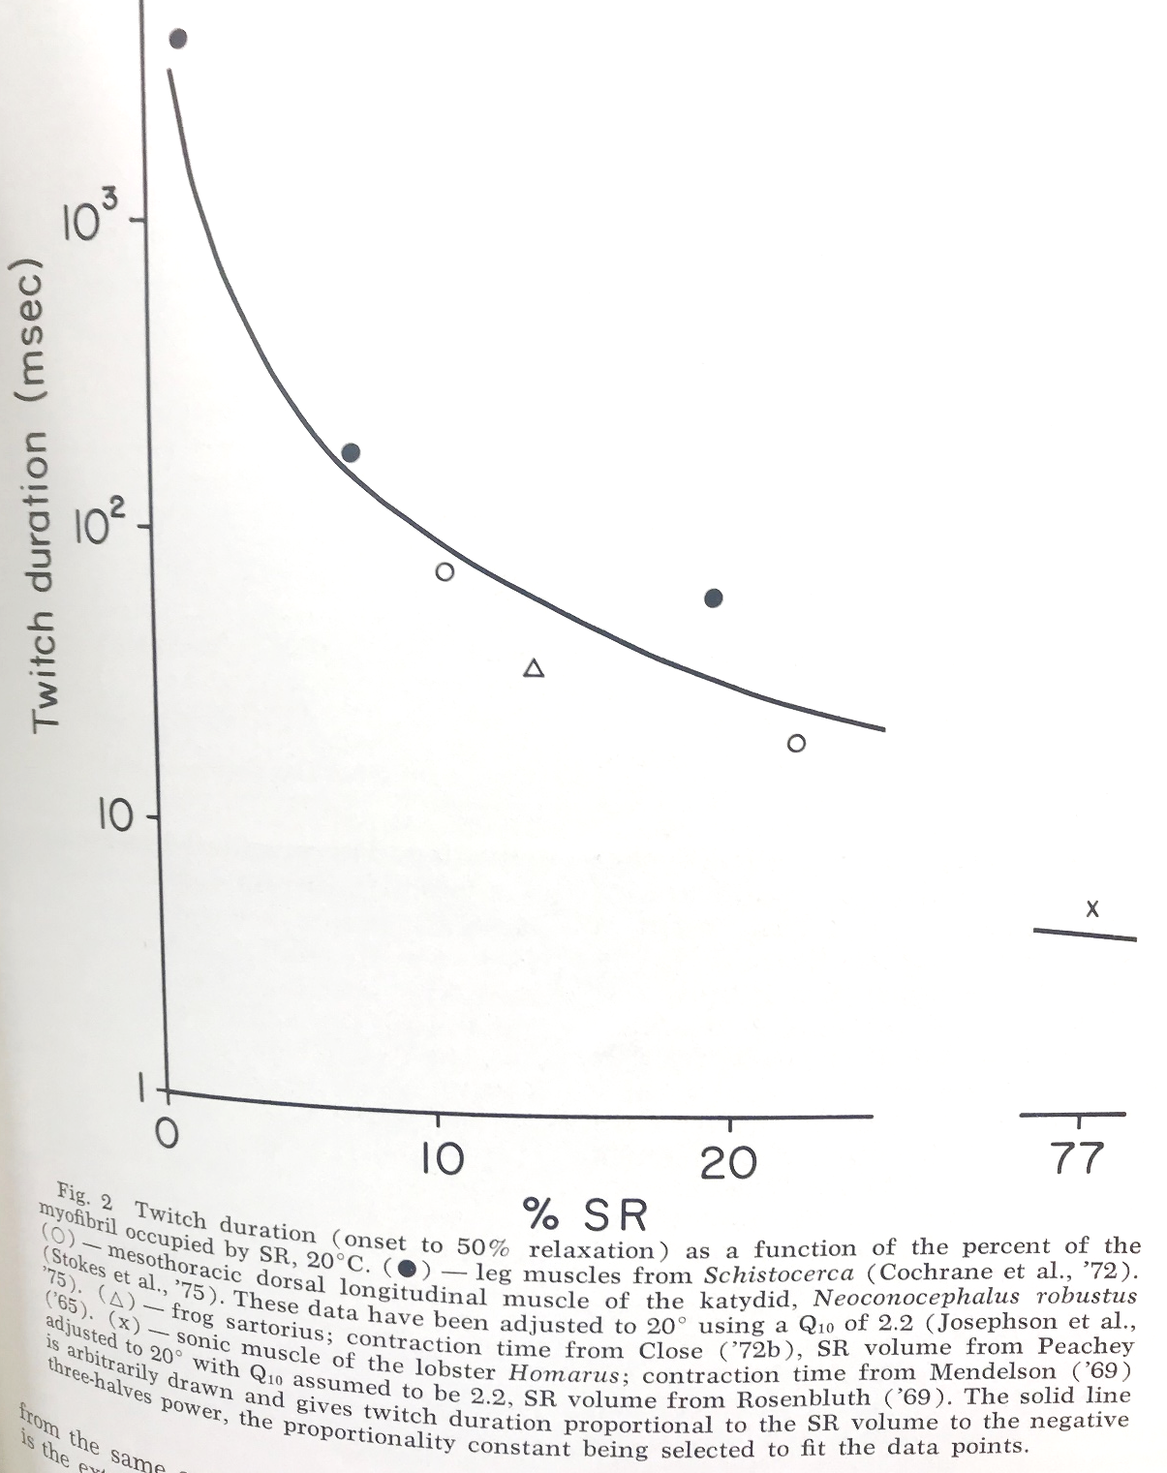

Slide 25
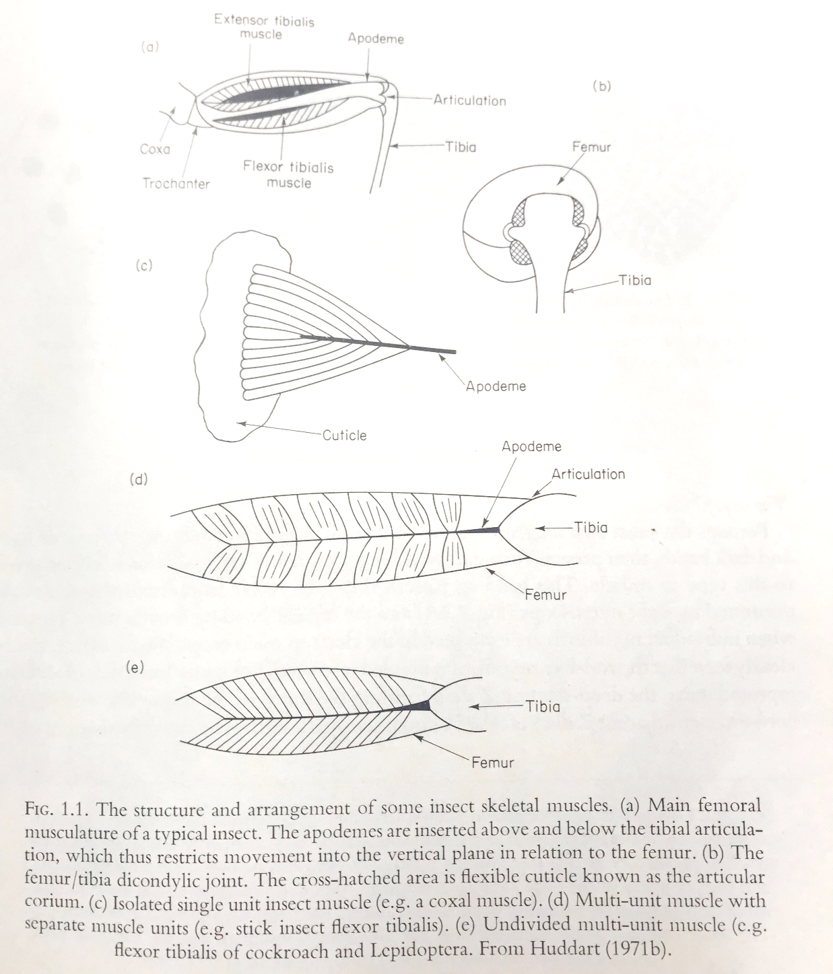

Slide 26
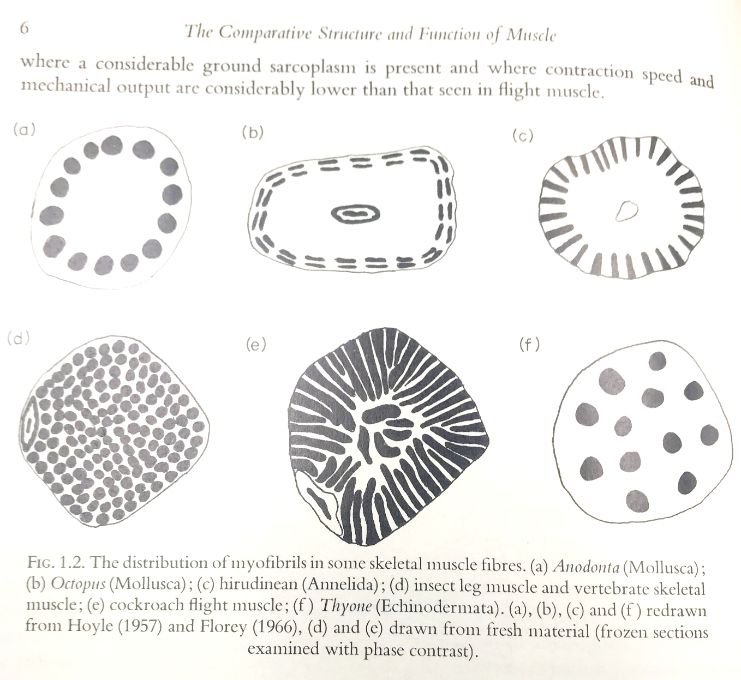

Slide 27
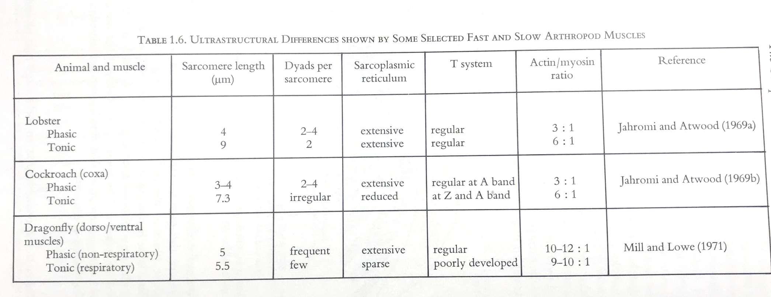
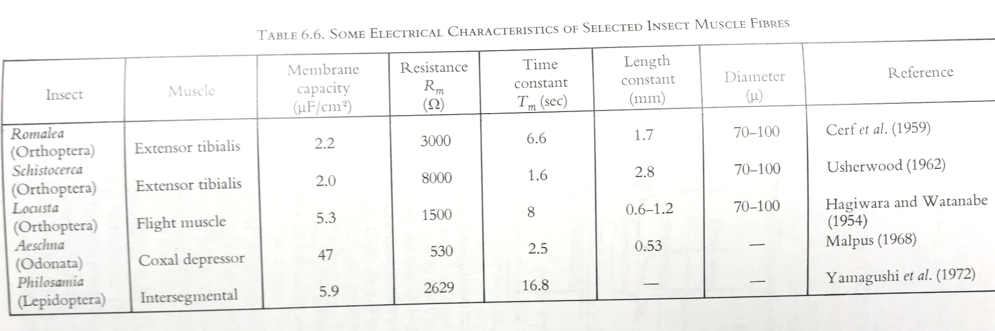

Slide 28
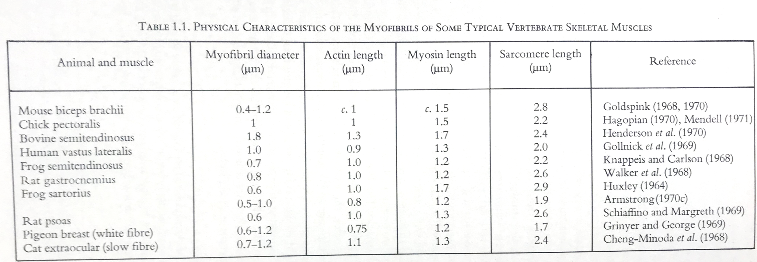
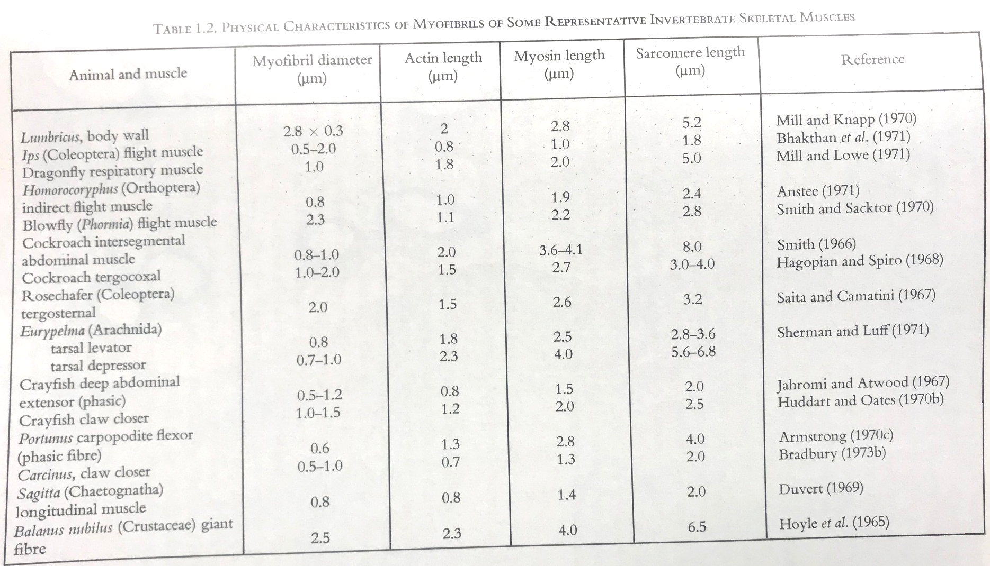

Slide 29
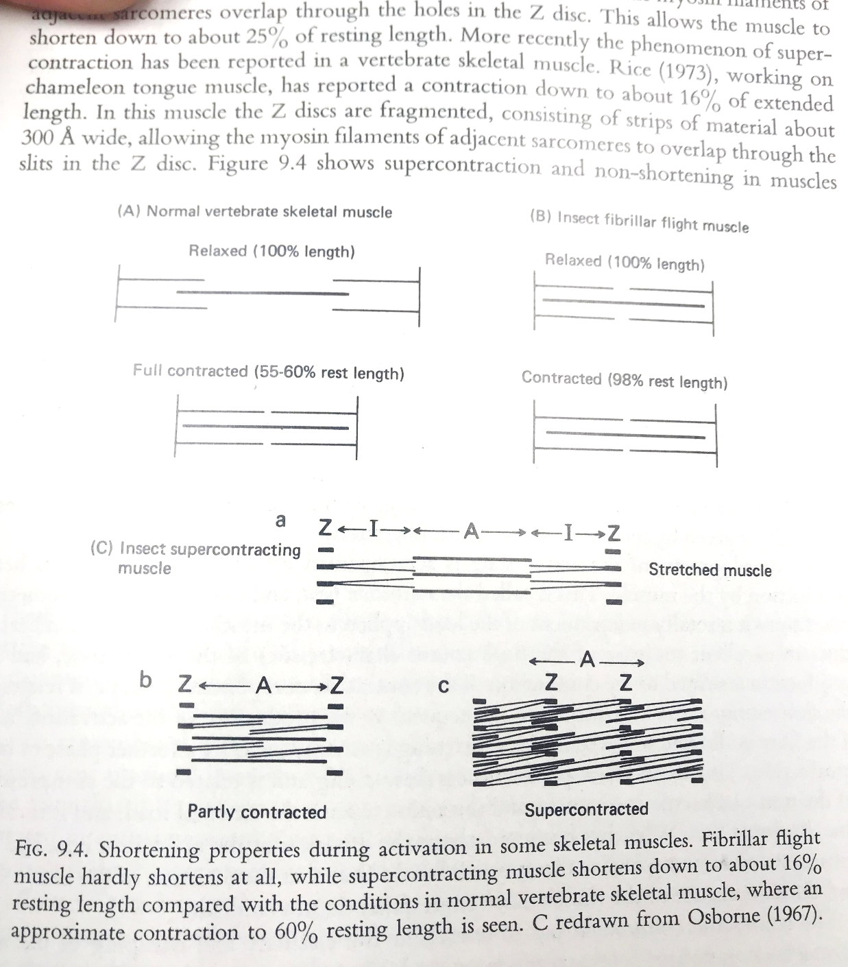

Slide 30
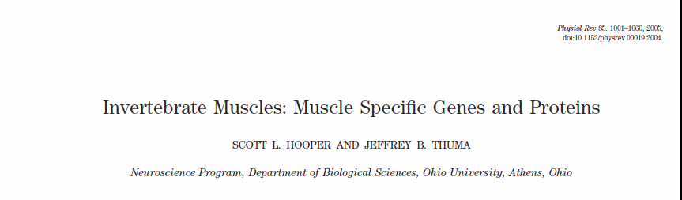

Slide 31
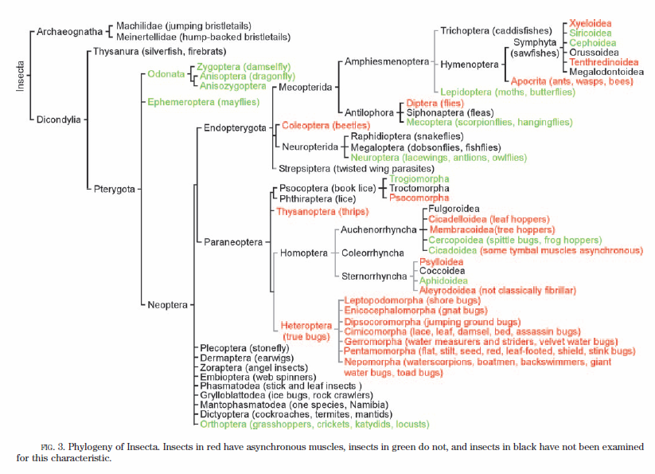

Slide 32
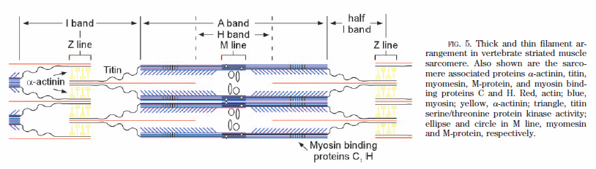

Slide 33
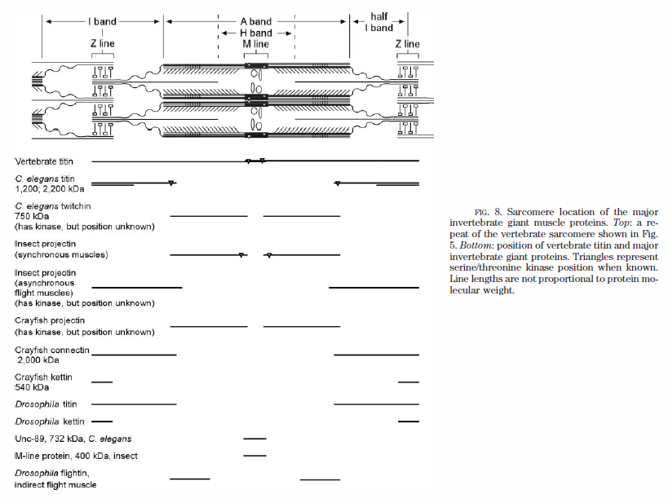

Slide 34
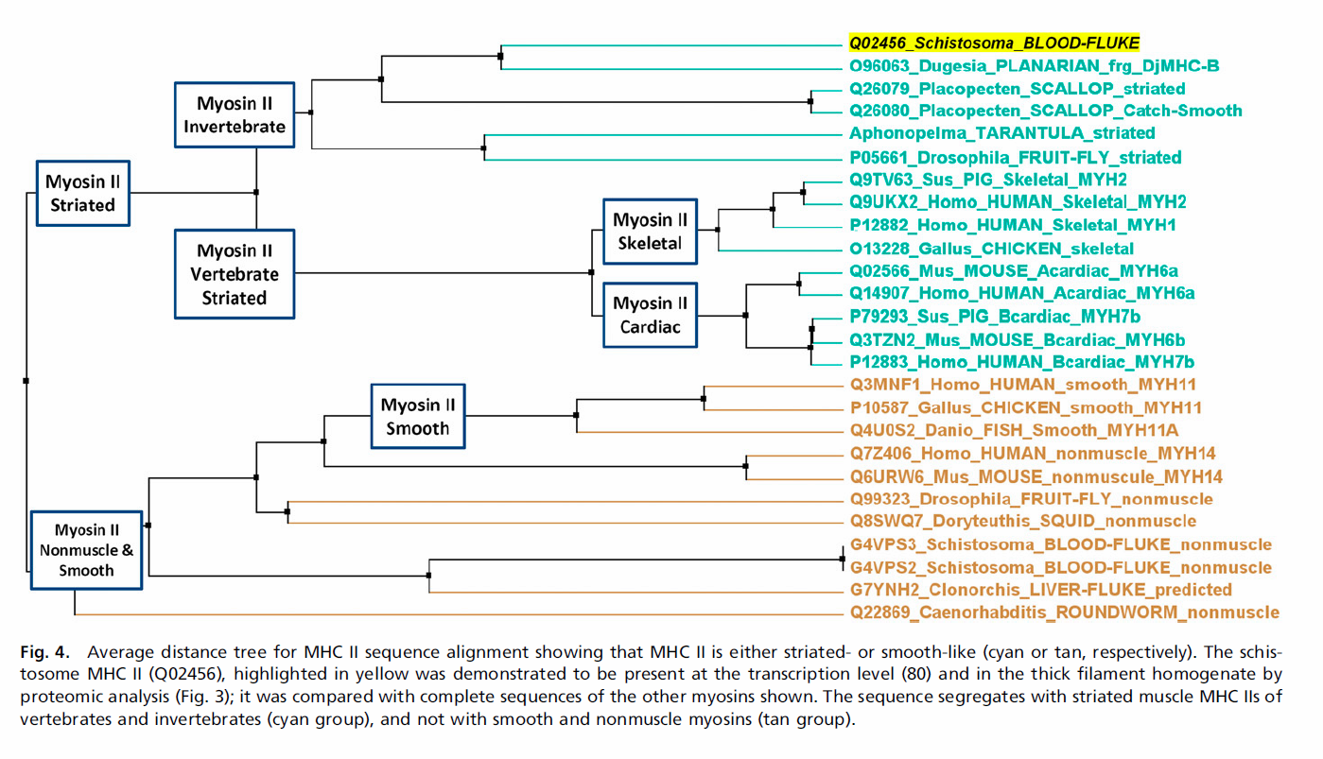

Slide 35
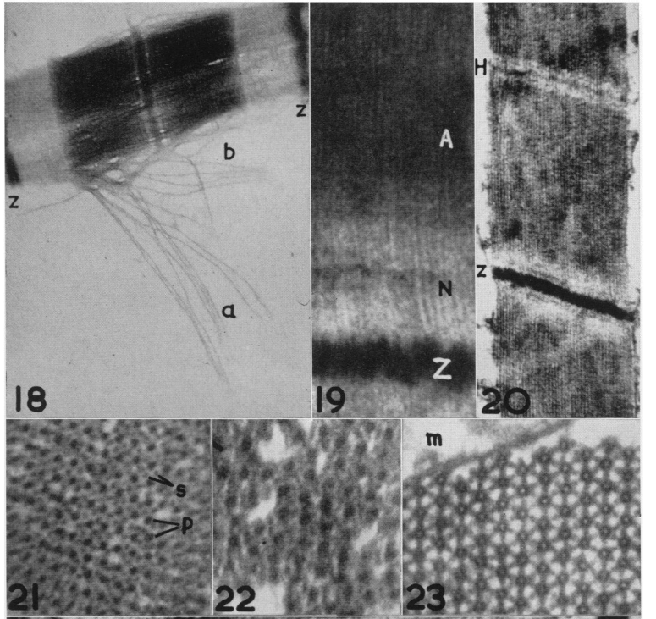

Slide 36
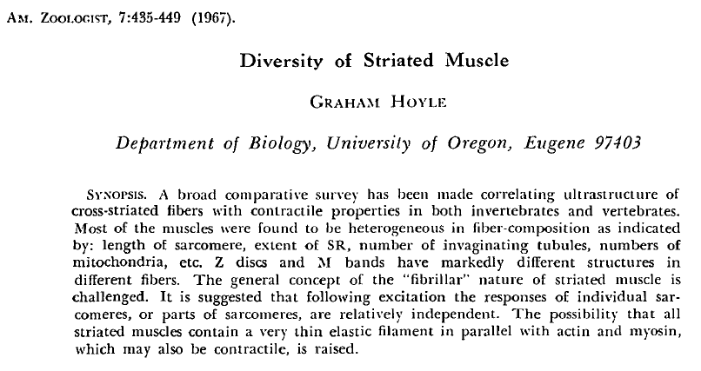

Slide 37
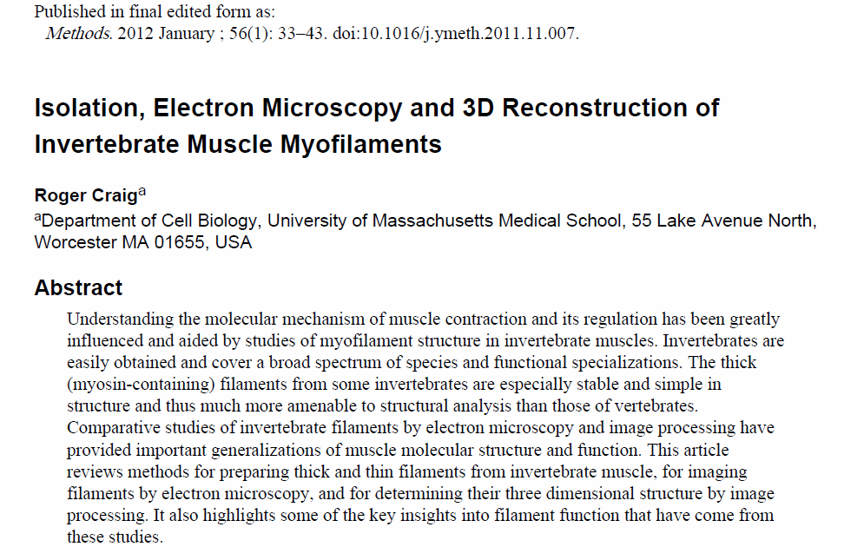

Slide 38
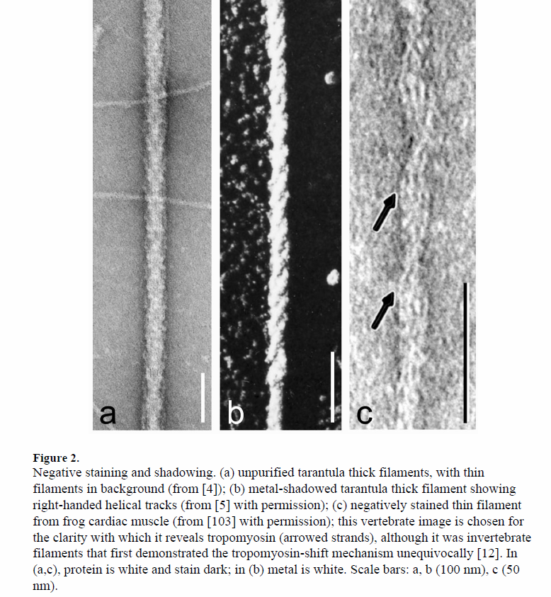

Slide 39
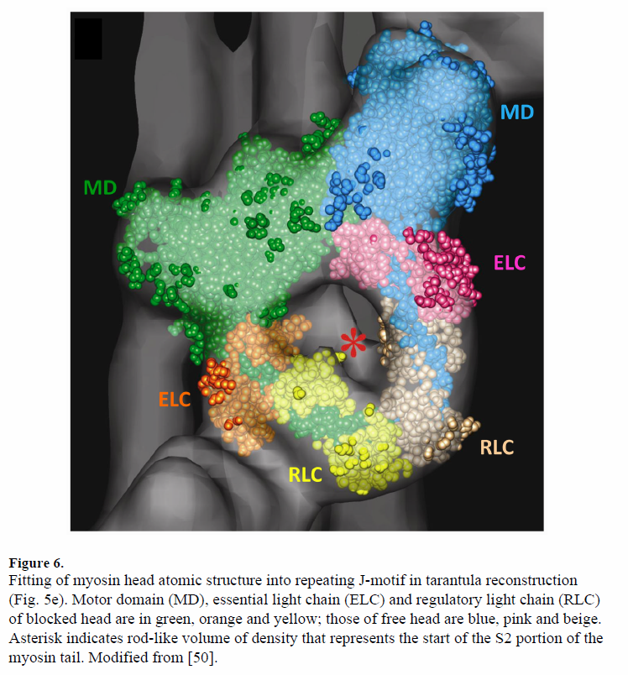

Slide 40
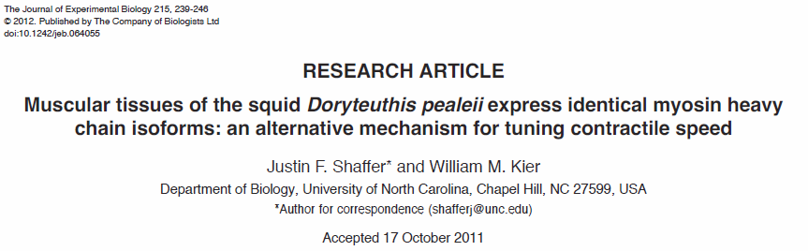
We identified three myosin heavy chain isoforms in squid muscular tissues, with differences arising at surface loop 1 and the carboxy terminus. All three isoforms were detected in all five tissues studied. These results suggest that the muscular tissues of D. pealeii express identical myosin isoforms, and it is likely that differences in muscle ultrastructure, not myosin ATPase activity, represent the most
important mechanism for tuning contractile speeds.

Slide 41
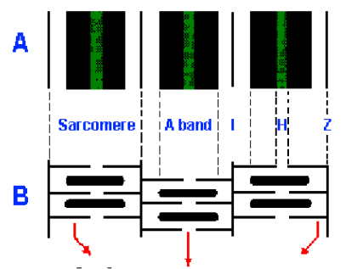
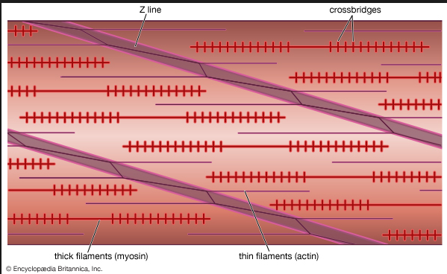
This rapid strike is caused by contraction of transverse muscle in the core of the tentacular stalk. The tentacle transverse muscle is unusual amongst cephalopods, as it includes fibres that are cross-striated with short thick filaments and sarcomeres (~0.8um thick filament length), whereas most cephalopod muscle is obliquely striated with long thick filaments [e.g. the thick filaments of arm transverse muscle fibres are ~7.4um (Kier and Curtin, 2002)]. Measurements of shortening velocities in transverse muscle tissue preparations revealed that the transverse muscle of the tentacle contracts nearly 10 times faster than the transverse muscle of the arm [15 vs 1.5 muscle lengths s–1, respectively (Kier and Curtin, 2002)]. This 10-fold greater contractile speed in the tentacles is expected given the observed differences
between the transverse muscle ultrastructure in the arms and tentacles. Because the tentacle fibres contain 10-fold more sarcomeres per unit length than the arm muscle and the shortening velocity is proportional to the number of elements in series (Huxley and Simmons, 1973; Josephson, 1975), the contractile speed of the transverse muscle of the tentacle is predicted to be 10-fold faster than that of the arm, which indeed it is (Kier and Curtin, 2002).
cross-striated
obliquely striated

Slide 42
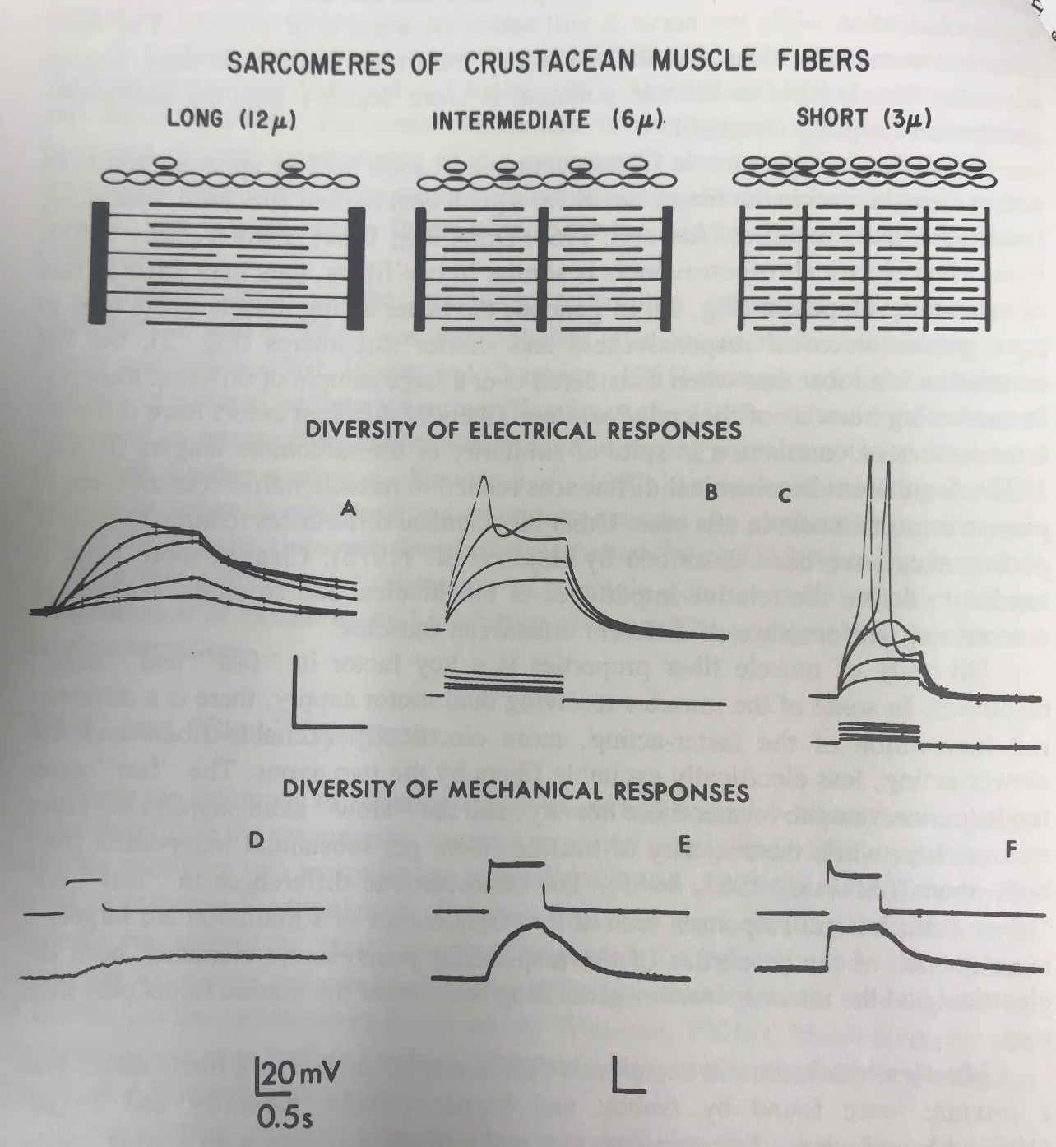
General differences in NMJ physiology of crustaceans

Slide 43
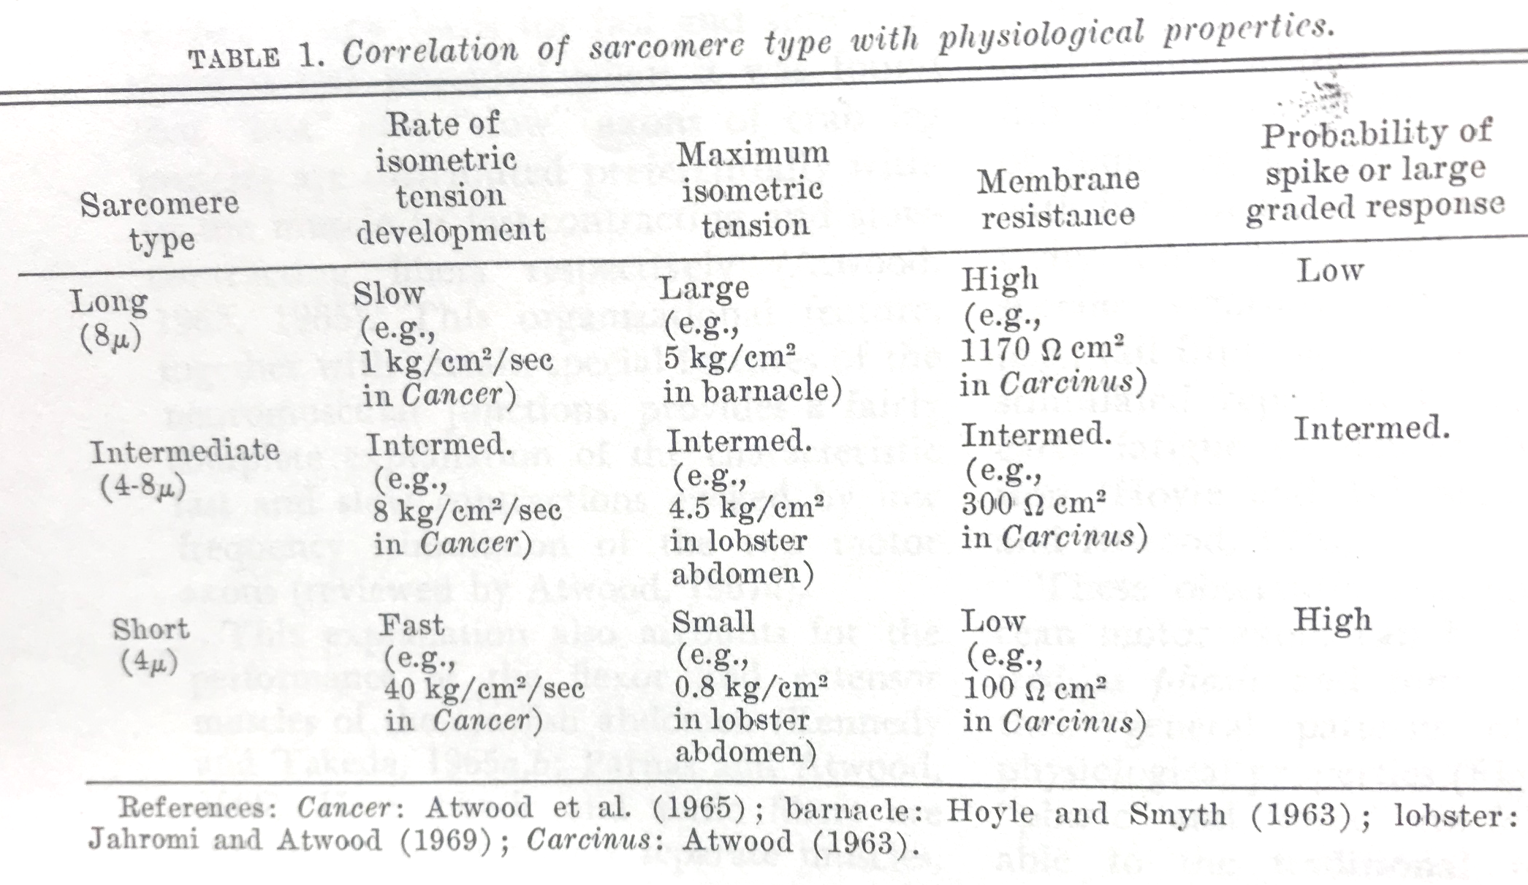

Slide 44
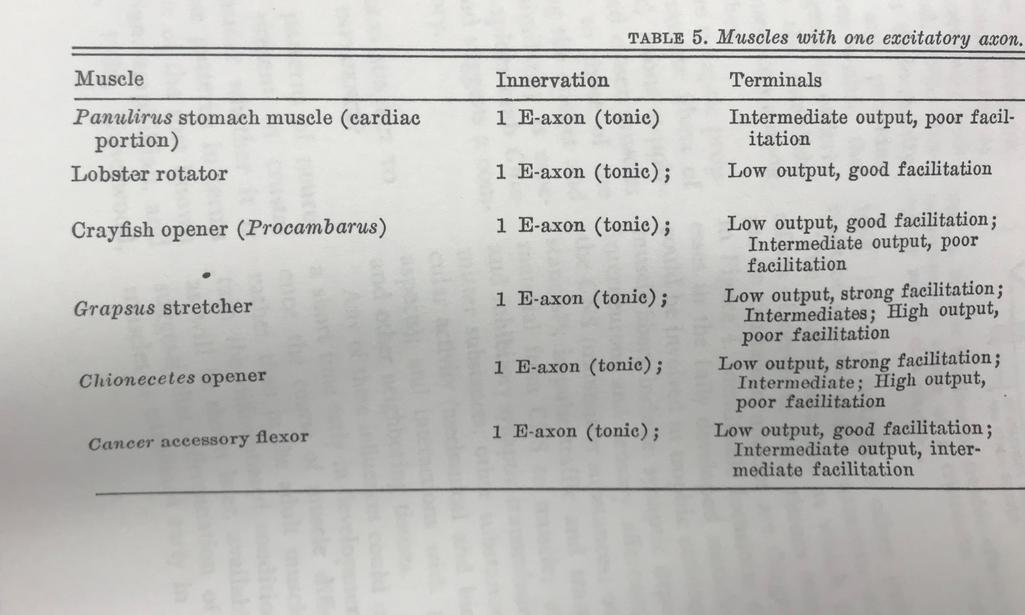

Slide 45
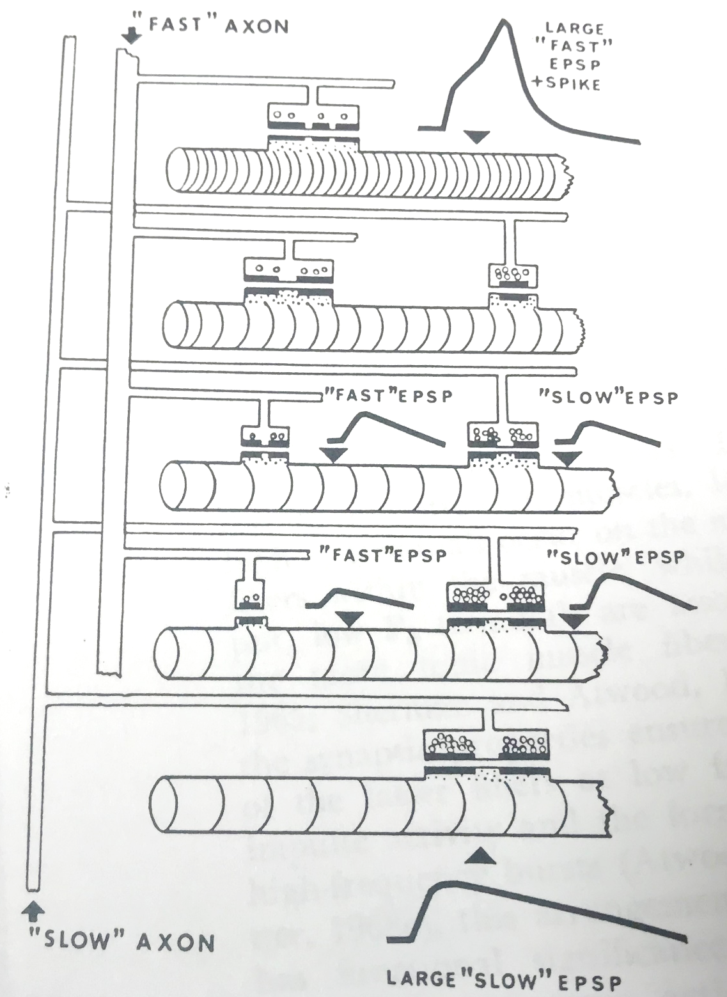

Slide 46
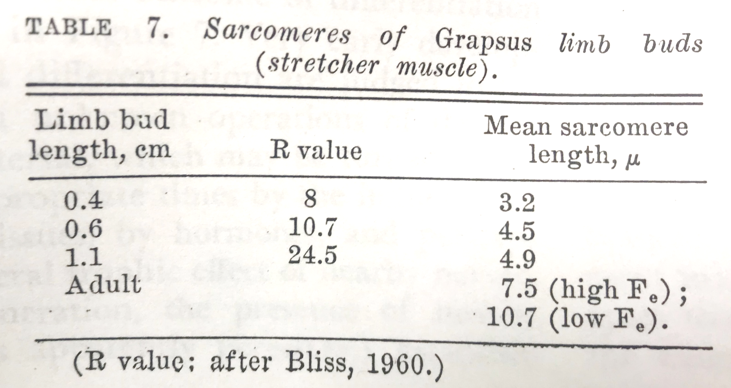

Slide 47
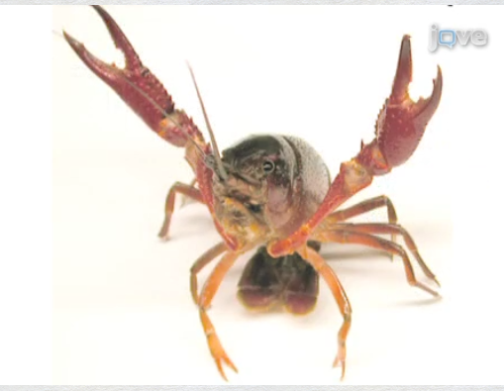
Crayfish

Slide 48
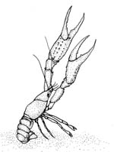
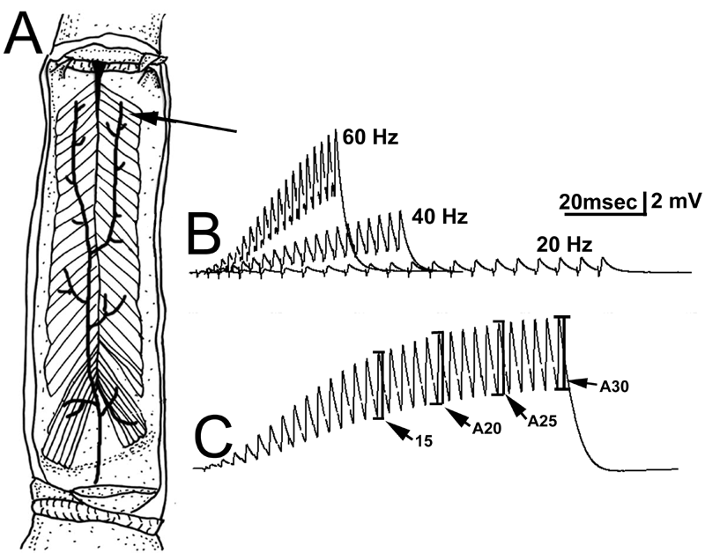

Slide 49
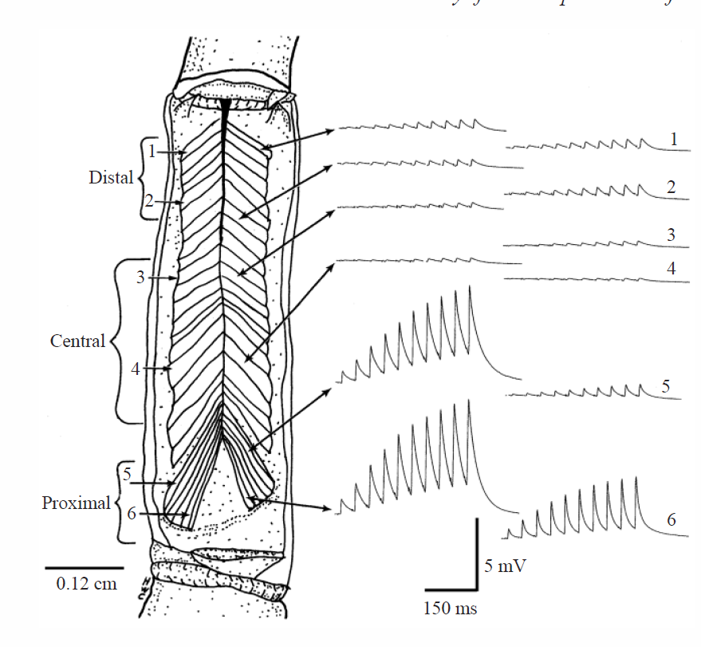
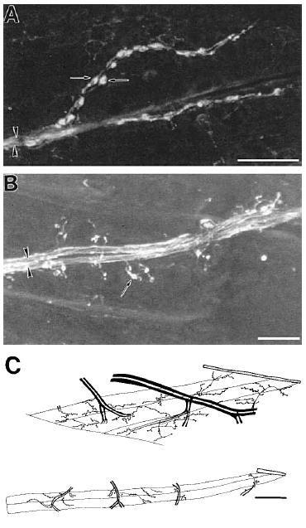

Slide 50
Leg extensor muscle
?
?

